Slide 1
CS 367-305/306/307
Recitation 12 – Virtual Memory

Slide 2
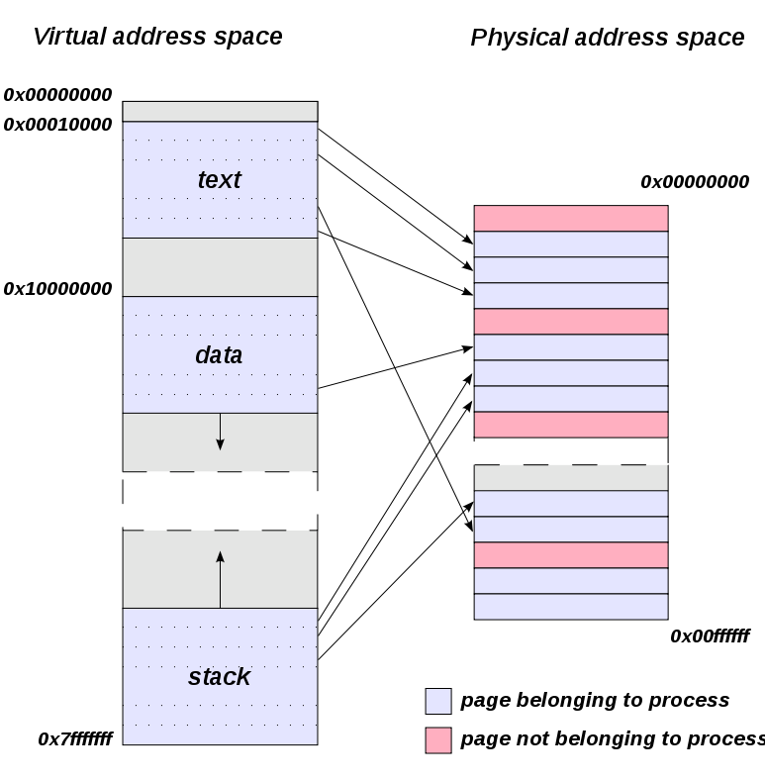
Virtual Pages
Every process has its own separate address space
Virtual addresses map to physical addresses
Physical address?

Slide 3
Virtual Pages
Every process has its own separate address space
Virtual addresses map to physical addresses
Physical address
The address of a specific storage cell in main memory (DRAM)
Who translates Virtual Addresses to Physical Addresses?

Slide 4
Virtual Pages
Every process has its own separate address space
Virtual addresses map to physical addresses
Physical address
The address of a specific storage cell in main memory (DRAM)
Who translates Virtual Addresses to Physical Addresses?
MMU

Slide 5
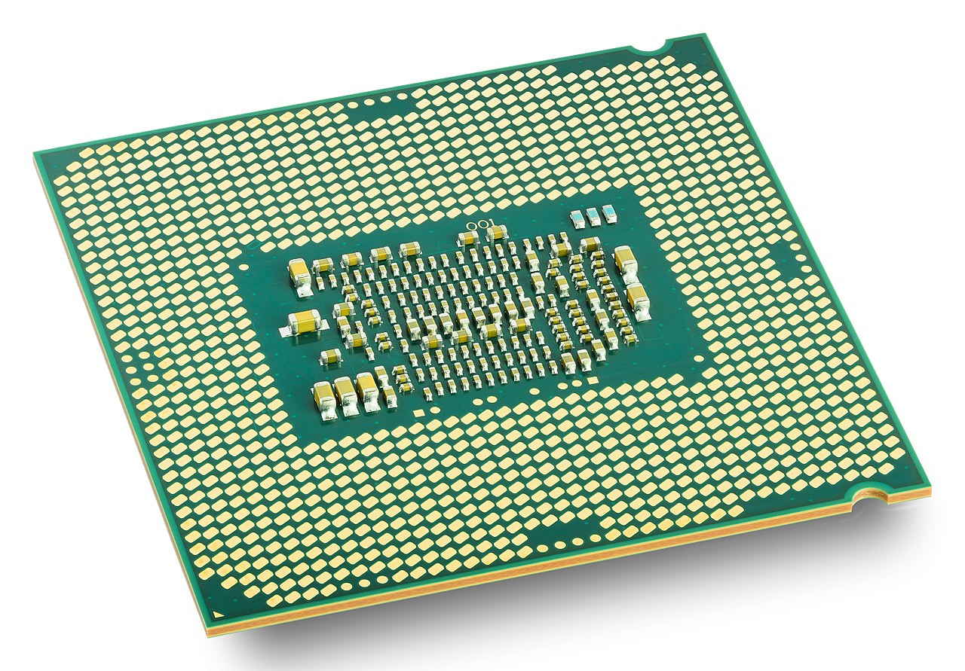
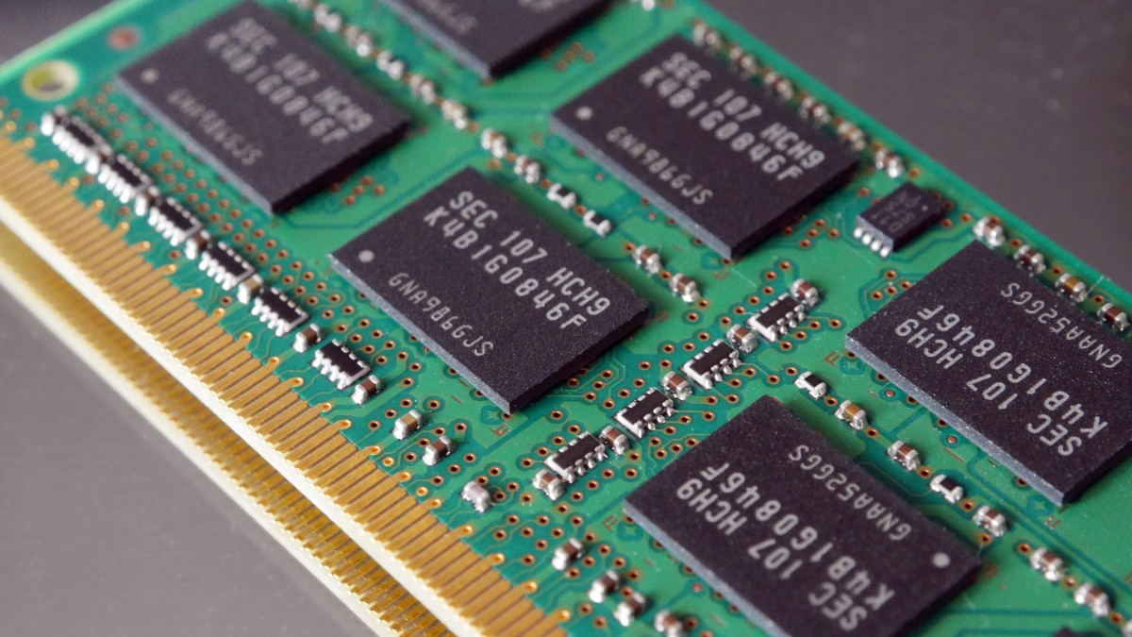
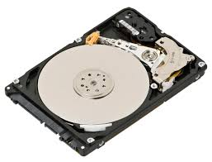
How Computers Actually Work
Memory
HDD/SSD
CPUs
Bus
Bus

Slide 6
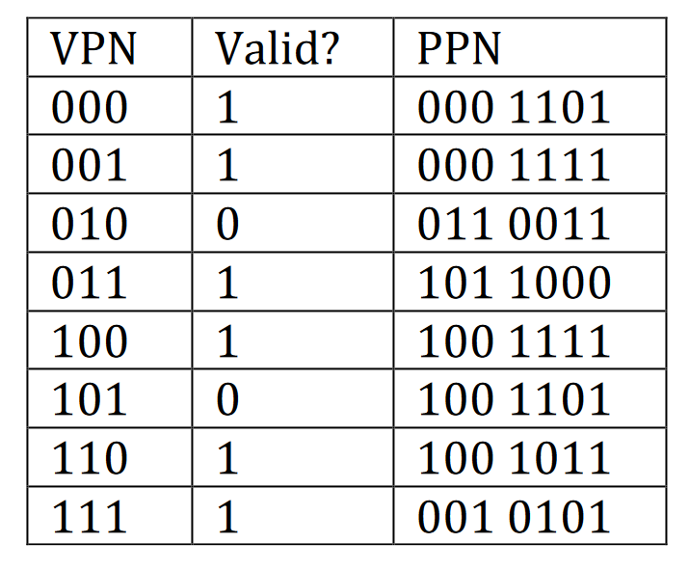
Virtual Pages
REMEMBER PPO = VPO
PAs can be decomposed to PPN | PPO
VAs can be decomposed to VPN | VPO
VA = 0x14 = 0001 0100

Slide 7
Virtual Pages
REMEMBER PPO = VPO
PAs can be decomposed to PPN | PPO
VAs can be decomposed to VPN | VPO
VA = 0x14 = 0001 0100
VPN|VPO = 000 10100

Slide 8
Virtual Pages
REMEMBER PPO = VPO
PAs can be decomposed to PPN | PPO
VAs can be decomposed to VPN | VPO
VA = 0x14 = 0001 0100
VPN|VPO = 000 10100
PPN = 0001101

Slide 9
Virtual Pages
REMEMBER PPO = VPO
PAs can be decomposed to PPN | PPO
VAs can be decomposed to VPN | VPO
VA = 0x14 = 0001 0100
VPN|VPO = 000 10100
PPN = 0001101
PA (PPN|PPO) = 0001101 10100 = 0001 1011 0100 = 0x1b4

Slide 10
Virtual Pages
REMEMBER PPO = VPO
PAs can be decomposed to PPN | PPO
VAs can be decomposed to VPN | VPO
VA = 0x14 = 0001 0100
VPN|VPO = 000 10100
PPN = 0001101
PA (PPN|PPO) = 0001101 10100 = 0001 1011 0100 = 0x1b4
IF YOU HAVE A PAGE TABLE MISS…
IT’S A PAGE FAULT!

Slide 11
TLB
Very similar to cache
TLBT – TLB Tag
TLBI – TLB Index
CT – Cache Tag
CI – Cache Index
CO – Cache Offset

Slide 12
TLB
Very similar to cache
TLBT – TLB Tag
TLBI – TLB Index
CT – Cache Tag
CI – Cache Index
CO – Cache Offset
Rules
You must first retrieve the page number (PPN), then retrieve the data
To retrieve PPN, look at the TLB. If you miss, go to the Page Table (PT). If it’s also a miss, Page Fault
To retrieve the byte, look in the cache for the physical address
If you miss, you must go in main memory

